Slide 1

Visual Basic for Application - Theoretical (Lecture 3)
Written By: Kim M Pambid
Reference:
https://learn.microsoft.com/en-us/
https://www.wallstreetmojo.com/
https://www.automateexcel.com/
https://stackoverflow.com/
https://www.wikipedia.org/
https://www.techonthenet.com/

Slide 2
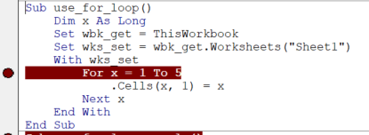
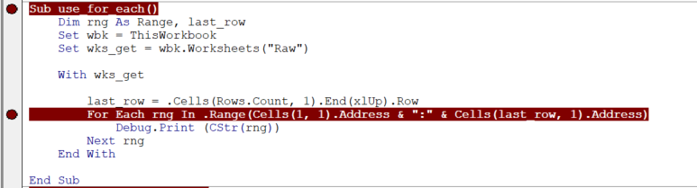
Looping and Skipping
a.1. For Next Loop - iteration statement to loop a pre-set number of times and control the iteration process.
a.2. For Each Next - used to execute a statement or a group of statements for each element in an array or collection.

Slide 3
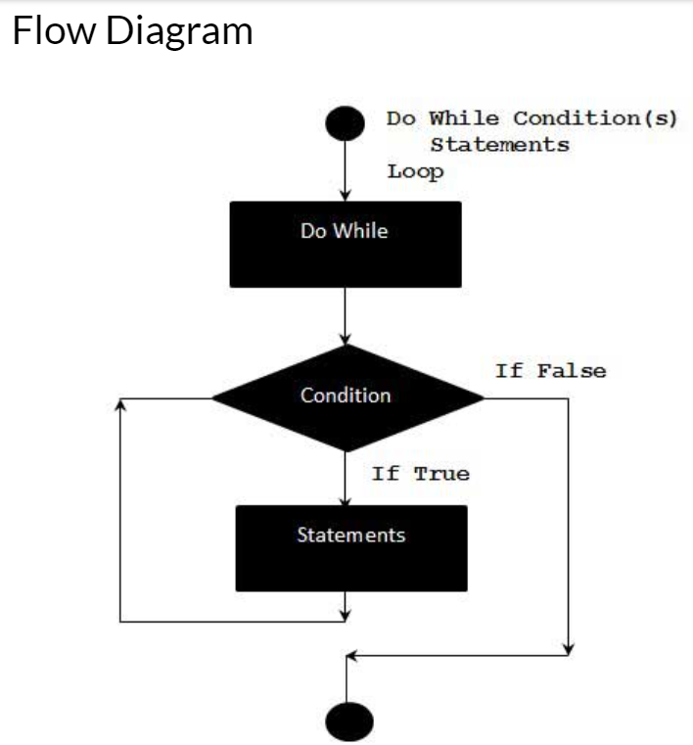
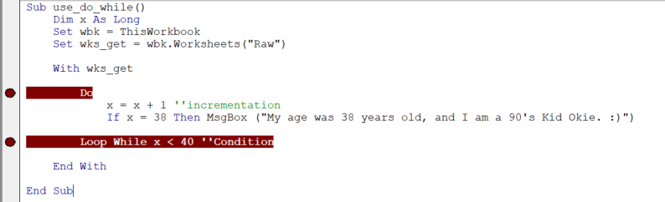
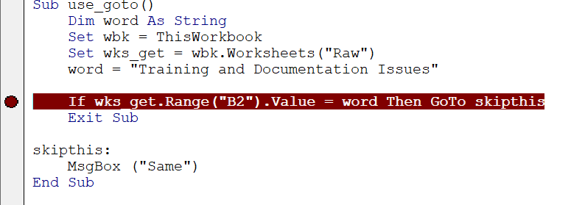
a.3. Do While - used when we want to repeat a set of statements as long as the condition is true. .
a.4. Goto - statement to branch to line labels within a procedure.

Slide 4
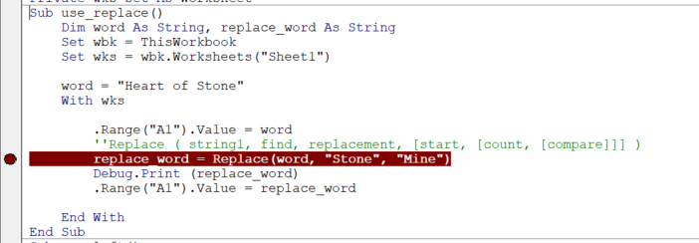
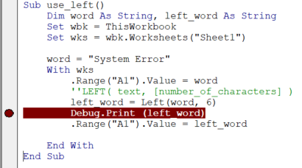
B. Text Alterations
b.1. Replace - Replaces a sequence of characters in a string with another set of characters.
b.2. Left – Return the sequence of characters that begin on the left side of the string.

Slide 5
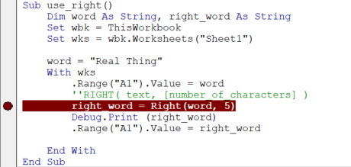
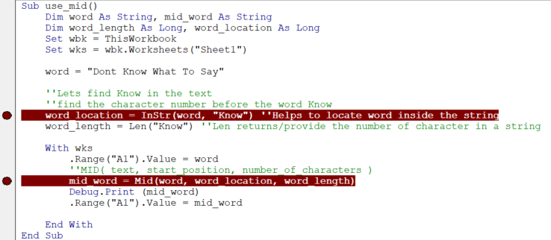
b.3. Right – Return the sequence of characters that begin on the right side of the string.
b.4. Mid – extracts the values from the middle of the supplied sentence or word and categorizes them under the String and Text function.
Notes:
InStr - Helps to locate word inside the string
Len - returns/provide the number of character in a string

Slide 6
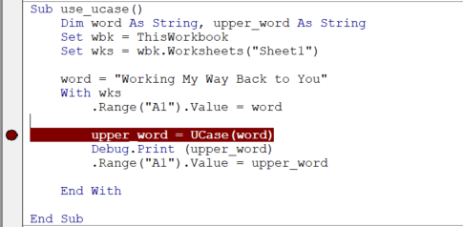
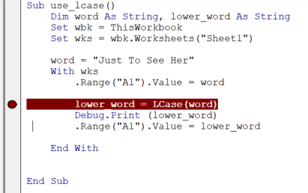
b.5. UCASE – upper case the string.
b.6. LCASE – lower case the string

Slide 7
30 mins review

Slide 8
Knowledge Check Quiz
5 Questions : )

